Slide 1
SOEN 343
5a. Introduction to design patterns
Dr. Morales

Slide 2
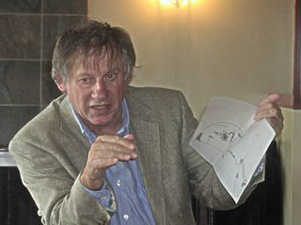
Patterns origins
1977 et 1979: Architecture
Christopher Alexander
A Pattern Language: Towns, Buildings, Construction and the idea of generative patterns
When buildings were successful, they tended to share characteristics
By knowing what those patterns are, you could arrive at successful design more quickly
Notes:
He noticed that when buildings were successful, they tended to share characteristics. In other words, if you look at a specific aspect of a building, what makes a room pleasant for example, Alexander noticed that there were certain characteristics of pleasant rooms. Light for instance would come into the room from two adjacent walls. So he made a catalog then of those patterns in architecture.

Slide 3
Definition
“Each pattern describes a problem which occurs over and over again in our environment, and then describes the core of the solution to that problem, in such way that you can use this solution a million times over, without ever doing it the same way twice.”
“Each pattern is a three part rule, which express a relation between a context, a problem, and a solution.”
—Christopher Alexander, 1977

Slide 4

The notion of design patterns is two-fold
Solution to recurring problem
A way to communicate design decisions
(i.e., shared vocabulary)

Slide 5
The notion of design patterns is two-fold
Solution to recurring problem
A way to communicate design decisions
(i.e., shared vocabulary)

Slide 6
A pleasant room (corner office pattern)
It has natural light coming from two adjacent walls
Light source 1
Participants of the pattern
Corner office
Light source 2
Pattern Name
Notes:
if we were going to design a room to be pleasant, we could fall back to that corner office pattern that we were talking about a moment ago. In other words, you could say that a room is pleasant with respect to the lighting, at least, if you have natural light coming in from two adjacent walls. It doesn't matter how you do that. There's lots of ways that we could reify this pattern. In other words, these could be windows. One could be windows. One could be a French door. One could be a window. One could be a giant hole that we put in the wall with a bulldozer. As long as we get light coming in from two sides, we have a legitimate reification of the pattern. And if we don't have natural light coming in from two sides, we don't. So if this was a giant monitor, for example, that was showing you what you'd see if the wall wasn't there, then you wouldn't have a reification of the pattern, because the light would not be natural light. And the pattern calls for natural light.

Slide 7
A pleasant room (cross ventilation pattern)
A room is pleasant if it has cross ventilation
Light source 1
Light source 1
the cross ventilation design pattern shares some of the elements with the initial pattern
Corner office
Corner office
Two different design patterns coexisting at the same time, sharing the objects in the room
Light source 2
Light source 2
Cross
ventilation
Notes:
So one of the characteristics of a pleasant room is that you have cross ventilation is that air flows across the room, more or less at head height. And it flows across. It doesn't come down from the ceiling. So in order to get that to work, we need another window. Now this is a different design pattern. This is the cross ventilation design pattern. And it shares some of the elements with our initial pattern. In other words, the light source here is also an air source. And this new window over here is another aspect of the pattern, which is the air sink. So here we have two different design patterns coexisting at the same time, sharing the same physical objects in the room. And it will have exactly the same situation when we look at software.

Slide 8
The notion of design patterns is two-fold
Solution to recurring problem
A way to communicate design decisions
(i.e., shared vocabulary)

Slide 9
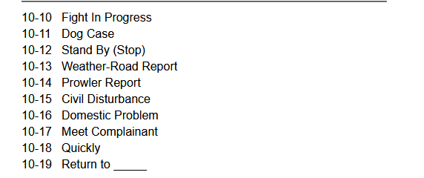

Shared vocabulary help to communicate ideas
We have a 10-10, repeat
Police 10 Codes (General Purpose)
Police and other agencies use 10 codes to verbally communicate efficiently
The word ten (10) indicates the next number, or numbers, is code.

Slide 10

Design patterns in software engineering
1990: object-oriented design
Erich Gamma, Richard Helm, Ralph Johnson, and John Vlissides†
Design Patterns drawn from experience
Elements of Reusable OO Software
23 patterns
Not a language?
“Dynamic, highly parameterized software is harder to understand and build than more static software”
Design patterns capture the best practices of experienced object-oriented software developers.
Design patterns are solutions to general software development problems.

Slide 11
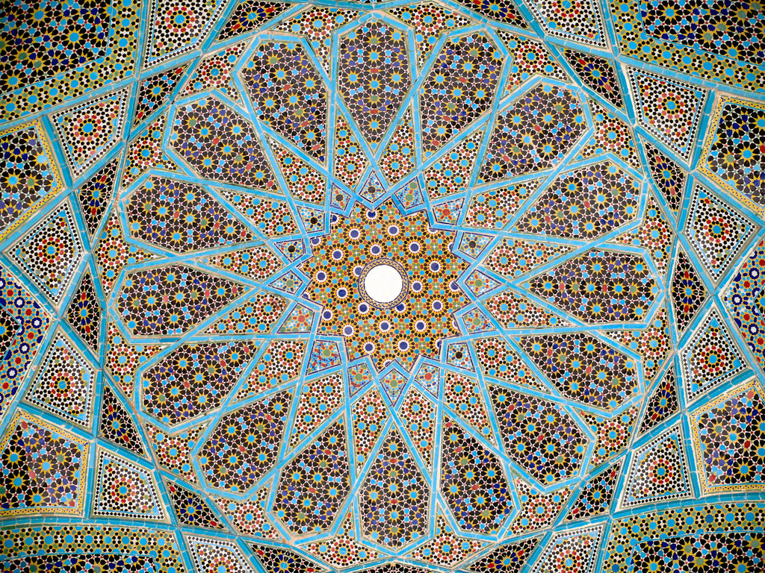
Design patterns in real world
In the real-world design patterns are mixed up with each other
(corner office and cross ventilation patterns)
The notion of patterns goes beyond object-oriented design
Enterprise architecture, functional programming, SOA, etc.
- Roof of Persian poet Hafez’s tomb.
Shiraz, Iran
Notes:
Classes that comprise the pattern might be already there

Slide 12
Design patterns classified by their intent
Creational patterns
Structural patterns
Behavioral patterns

Slide 13

Creational
Provide various object creation mechanisms, which increase flexibility and reuse of existing code
Factory Method
Abstract Factory
Prototype
Singleton

Slide 14

Structural
Explain how to assemble objects and classes into larger structures
Keep the new structures assembled flexible and efficient
Adapter
Bridge
Composite
Decorator
Façade
Flyweight
Proxy

Slide 15

Behavioral
Concerned with the assignment of responsibilities between objects
Identify common communication patterns between objects
Increase flexibility in carrying out this communication
Chain of responsibility
Command
Iterator
Mediator
Memento
Observer
State
Strategy
Template method
Visitor

Slide 16
Design patterns on practice Strategy pattern

Slide 17
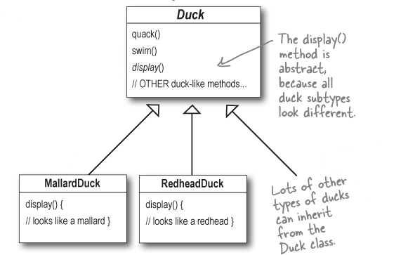
Duck simulator

Slide 18
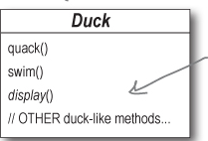
Ducks should fly… shouldn’t they?
The executives want to enhance the existing simulator with a new feature
What is the best way to add a flying behaviour to our duck simulator?
a) Add a concrete method fly() to the base class

Slide 19
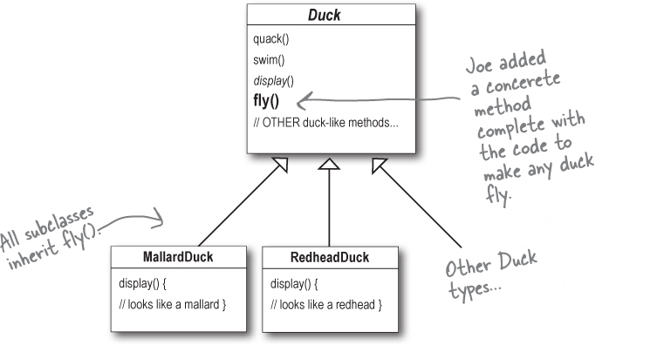
New duck simulator

Slide 20
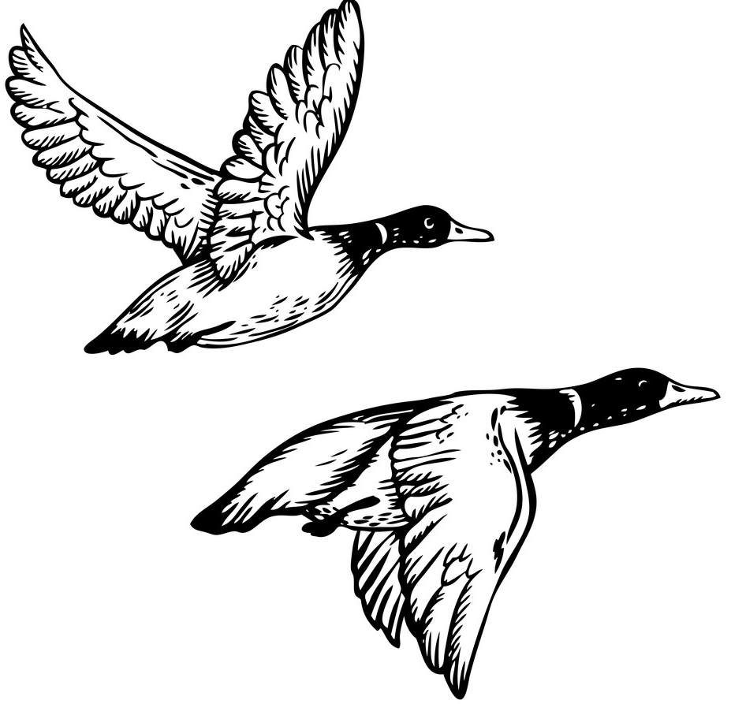

New duck simulator
Ducks fly
Duck simulator includes other types of ducks
rubber ducks, decoy ducks, etc.
Using a concrete method in the base class caused side effects on some subclasses
In other words a bug

Slide 21
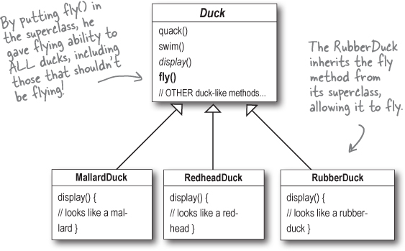
How to fix the duck simulator?
The problem is that different ducks have different behaviour
Requirements are always changing
The design is not prepared to deal with ducks having different types of behaviors
Notes:
Problems
1. Have to override few methods for the types that are not supposed to fly
2. Have to change the flying behavior in all flying duck subclasses

Slide 22

DRY design principle:
Identify the aspects of your application that vary and separate them from what stays the same
Notes:
take the parts that vary and encapsulate them, so that later you can alter or extend the parts that vary without affecting those that don’t

Slide 23
How to fix the duck simulator?
Two possible ways
Override the fly() method in the rubber duck
Make a flyable() interface with a fly (method)
Notes:
Problems
1. Have to override few methods for the types that are not supposed to fly
2. Have to change the flying behavior in all flying duck subclasses

Slide 24
The notion of design patterns is two-fold
Solution to recurring problem
A way to communicate design decisions (i.e., shared vocabulary)

Slide 25

Search the catalog

Slide 26
How to use catalog of Design patterns?
Get familiar with all the patterns and their relationships
Look at the motivation and applicability sections
Read consequences to prevent any unintended effect on your design

Slide 27
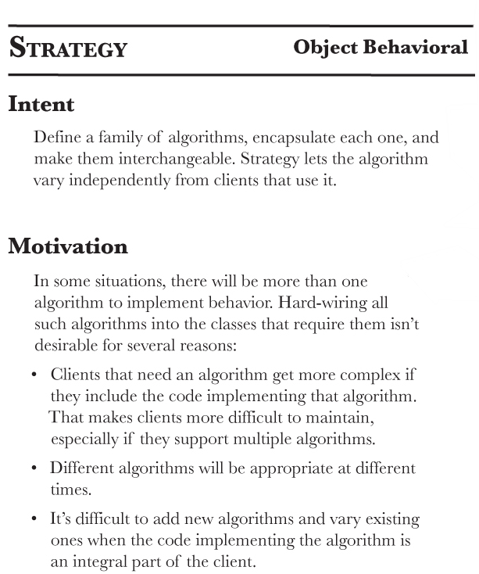




Slide 28
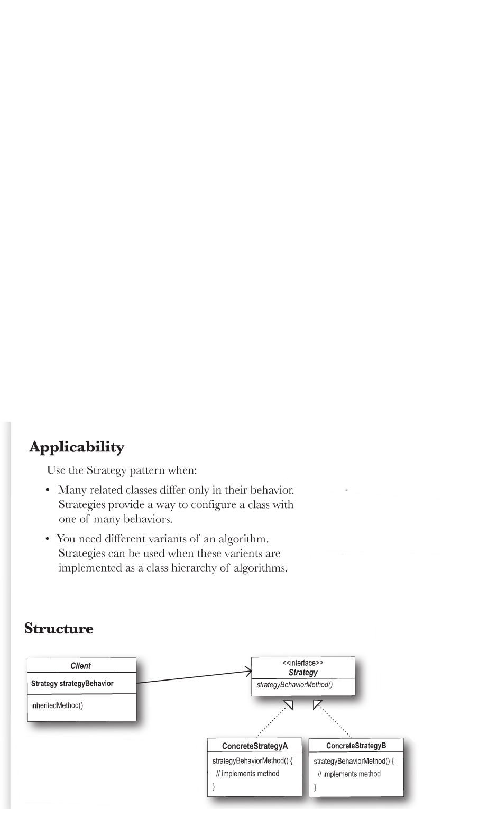

Fly behavior
Fly with wings
No Fly
Duck type

Slide 29
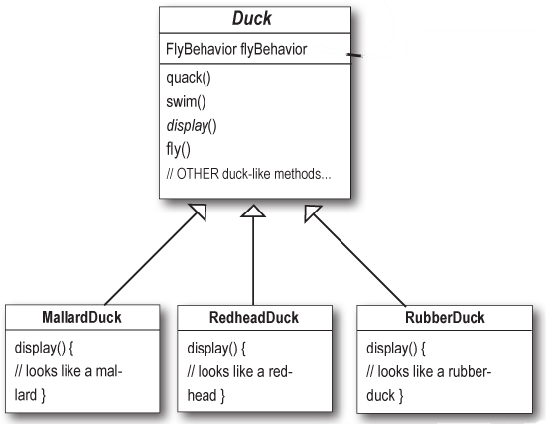
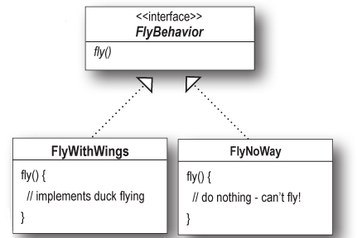
Duck simulator improved with strategy pattern

Slide 30
Code Strategy pattern
public interface FlyBehavior {
public void fly();
}
public abstract class Duck {
FlyBehavior flyBehavior;
public Duck() {
}
public void setFlyBehavior(FlyBehavior fb) {
flyBehavior = fb;
}
abstract void display();
public void performFly() {
flyBehavior.fly();
}
public void performQuack() {
System.out.println(“quack");
}
public void swim() {
System.out.println("All ducks float, even decoys!");
}
}
public class FlyWithWings implements FlyBehavior {
public void fly() {
System.out.println("I'm flying!!");
}
}
public class FlyNoWay implements FlyBehavior {
public void fly() {
System.out.println("I can't fly");
}
}
public class MallardDuck extends Duck {
public MallardDuck() {
flyBehavior = new FlyWithWings();
}
public void display() {
System.out.println("I'm a real Mallard duck");
}
}

Slide 31
Rubber and driver classes
public class RubberDuck extends Duck {
public RubberDuck() {
flyBehavior = new FlyNoWay();
}
public void display() {
System.out.println("I'm a rubber duck");
}
}
public class MiniDuckSimulator1 {
public static void main(String[] args) {
Duck mallard = new MallardDuck();
mallard.performFly();
mallard.display()
mallard.swim()
Duck rubbie = new RubberDuck();
rubbie.performFly();
rubbie.display()
rubbie.swim()
}
}

Slide 32
The notion of design patterns is two-fold
Solution to recurring problem
A way to communicate design decisions
(i.e., shared vocabulary)

Slide 33
Shared vocabulary helps to communicate ideas
Compare the following statements:
I encapsulated interface details in a base class, and buried implementation details in derived classes, so clients can couple themselves to an interface not an implementation
I implemented the strategy pattern
Notes:
Design patterns allow you to say more with less
Tallking at the pattern level allows you to stay in the design longer

Slide 34
Some considerations about Design patterns

Slide 35

Remarks
Design patterns allows to write code that is more flexible and maintainable
But they are not a silver bullet!
Refactoring time is patterns time
There are hundreds of patterns
Fundamental patterns
Domain specific
Notes:
Design patterns aren’t a magic bullet: They are time-tested techniques for solving problems, but you can’t just plug a pattern into a problem and take an early lunch. Think through how using a pattern will affect the rest of your design.
A great time to introduce patterns is when you need to refactor a design. You’re improving the organization and structure of your code anyway, so see if a pattern can help.

Slide 36

Warning:
Overuse of design patterns can lead to code that is over-engineered
Notes:
Patterns can help make more flexible designs, but they can also introduce complexity, which we want to reduce unless necessary. Just remember: complexity and patterns should be used only where they are needed for practical extensibility.es a problem in your design, and only if a simpler solution won’t work.

Slide 37
Design principle:
Keep it simple (KISS), always go with the simplest solution that does the job.
Notes:
Your goal should always be simplicity, so don’t feel like you always need to use a pattern to solve a problem.
Introduce design patterns where and when need emerges

Slide 38
Summary

Slide 39
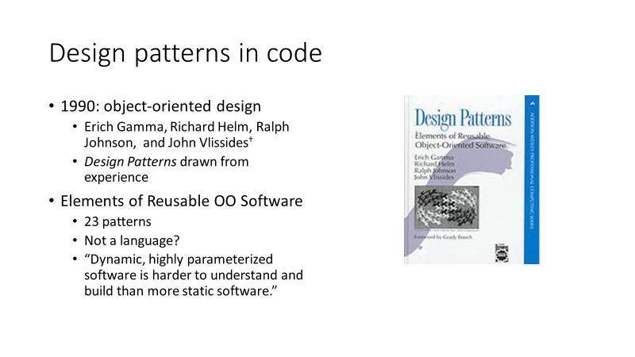
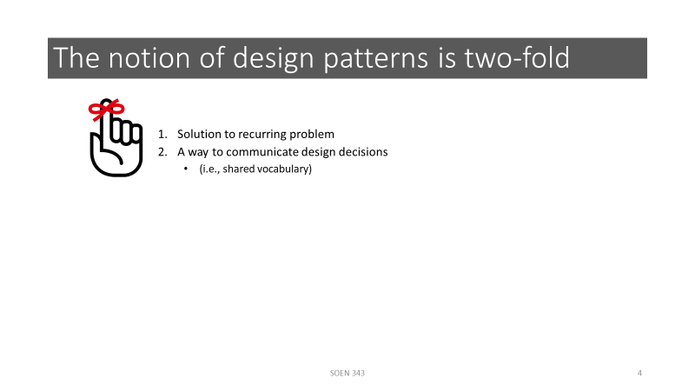
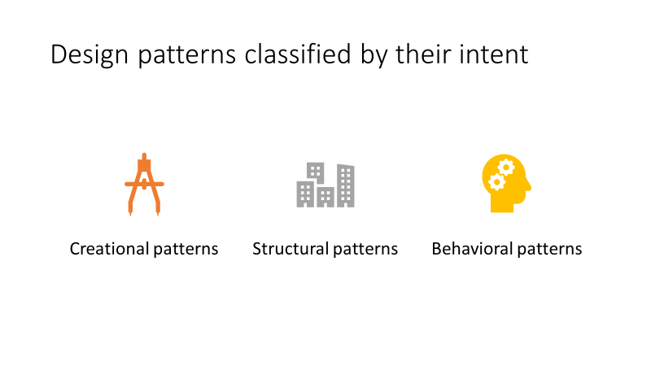
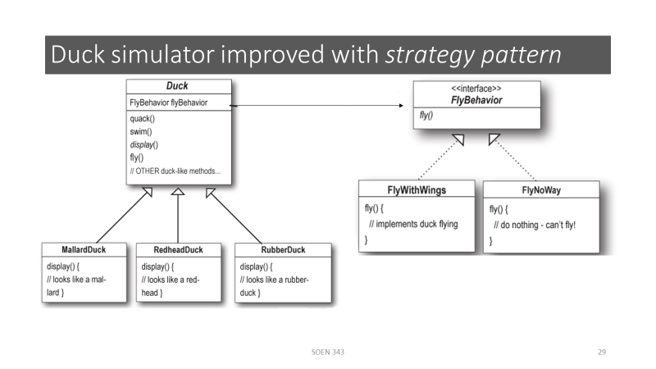

Slide 40
References
Christopher Alexander, Sara Ishikawa, Murray Silverstein, Max Jacobson, Ingrid Fiksdahl-King, and Shlomo Angel. A Pattern Language. Oxford University Press, New York, 1977.
Alexander, Christopher. The Timeless Way of Building. Oxford University Press, 1977. ISBN 978-0-19-502402-9.
Erich Gamma, Richard Helm, Ralph Johnson and John Vlissides, Design Patterns – Elements of Reusable Object-Oriented Software, Adisson-Wesley, 1995.
Freeman, Eric, et al. Head first design patterns. " O'Reilly Media, Inc.", 2008.
Source code of Duck simulator class https://github.com/bethrobson/Head-First-Design-Patterns/tree/master/src/headfirst/designpatterns/strategy

